Slide 1
OBESITÀ, FUNZIONE COGNITIVA E DEMENZA
LUIGI FRANZESE
Dipartimento di Psichiatria e Psicologia Unità: dca, obesità e chirurgia bariatrica Scuola di medicina, università Federico II di napoli

Slide 2
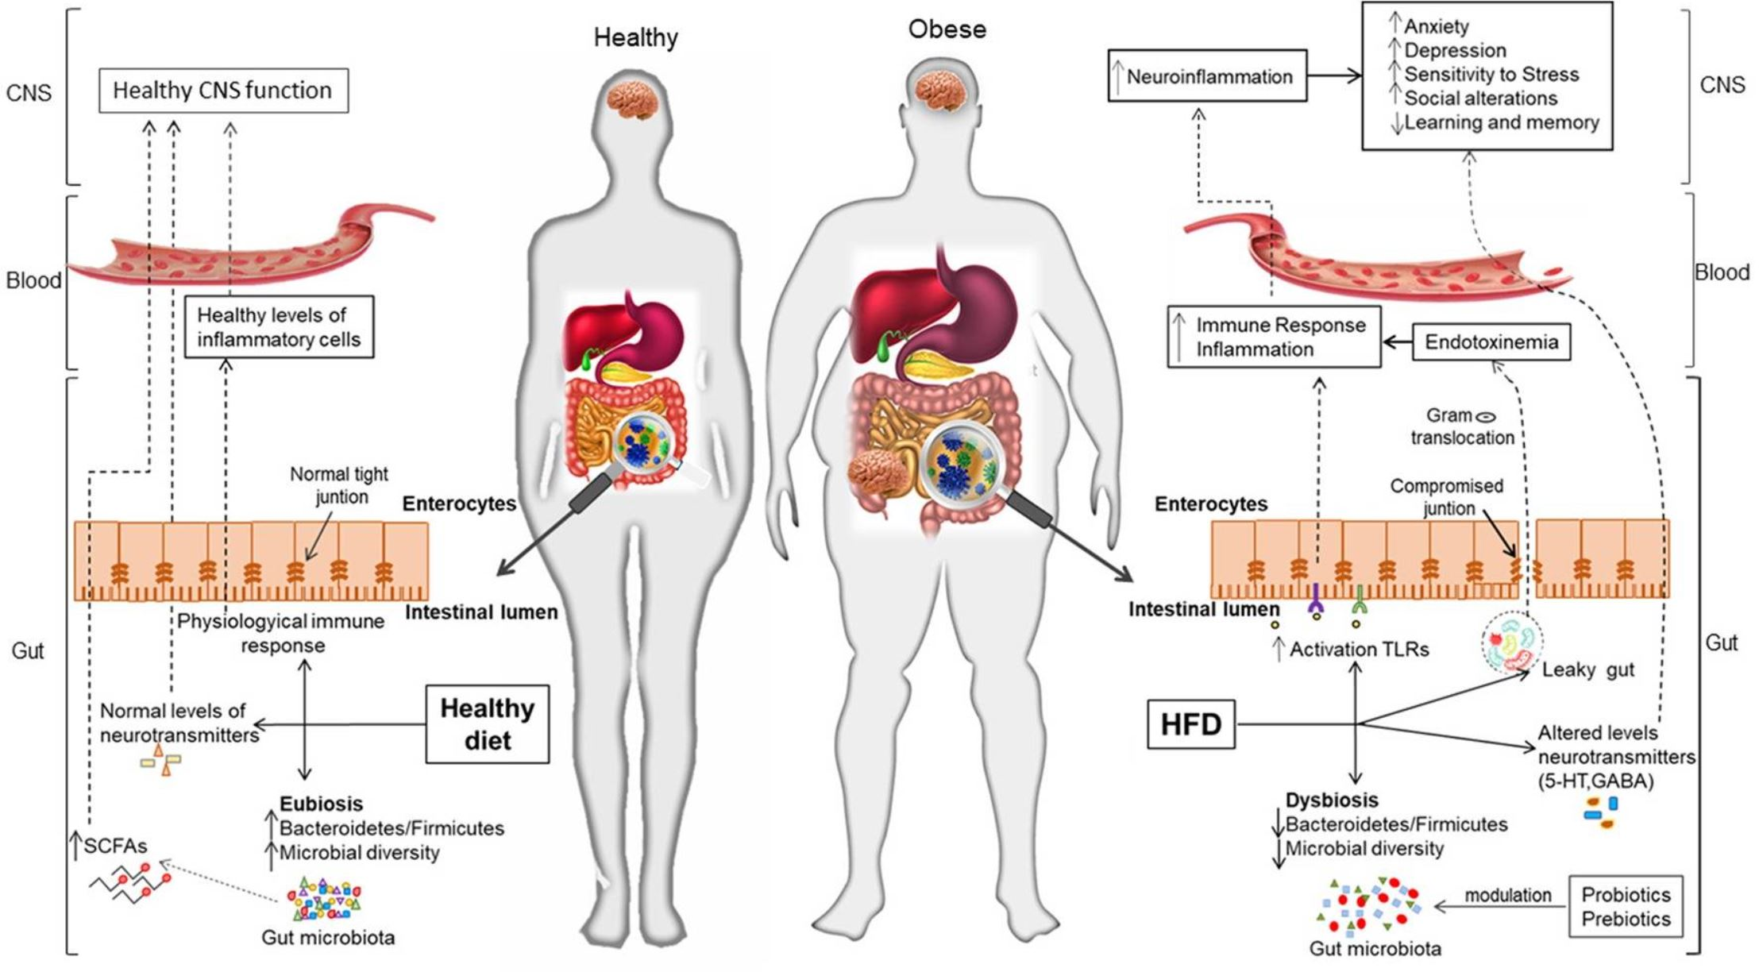
Obesità e funzione cognitiva

Slide 3
Quante e quali obesità?
Aging is characterized by a decline in lean body mass (i.e., sarcopenia) and an increase in adipose tissue without weight gain, a phenomenon that is not captured by BMI.
Waist circumference (WCir) and waist-hip ratio (WHR) appear to be better adiposity measures in elderly people as these indices of central obesity reflect the abdominal distribution of body fat.
Age and sarcopenia
Visceral fat is more active metabolically than subcutaneous fat and is thought to have a stronger influence on adipocytokine production and insulin resistance. Central obesity is a more potent risk factor for cardiovascular disease (CVD) and mortality than total body obesity assessed by BMI, and that this phenomenon may be related in part to the role of intra-abdominal fat (visceral adiposity) on metabolic abnormalities having known association with increased risk of diabetes and CVD.
Visceral fat VS subcutaneous fat
Metabolic syndrome
Diabetes
Cardiovascular diseases
OSAS
Stress and stigma
In dementia and stroke free individuals, WHR and WCir were more strongly associated with cognitive performance than BMI.
Comorbidities
Obesity-related anthropometric indicators

Slide 4
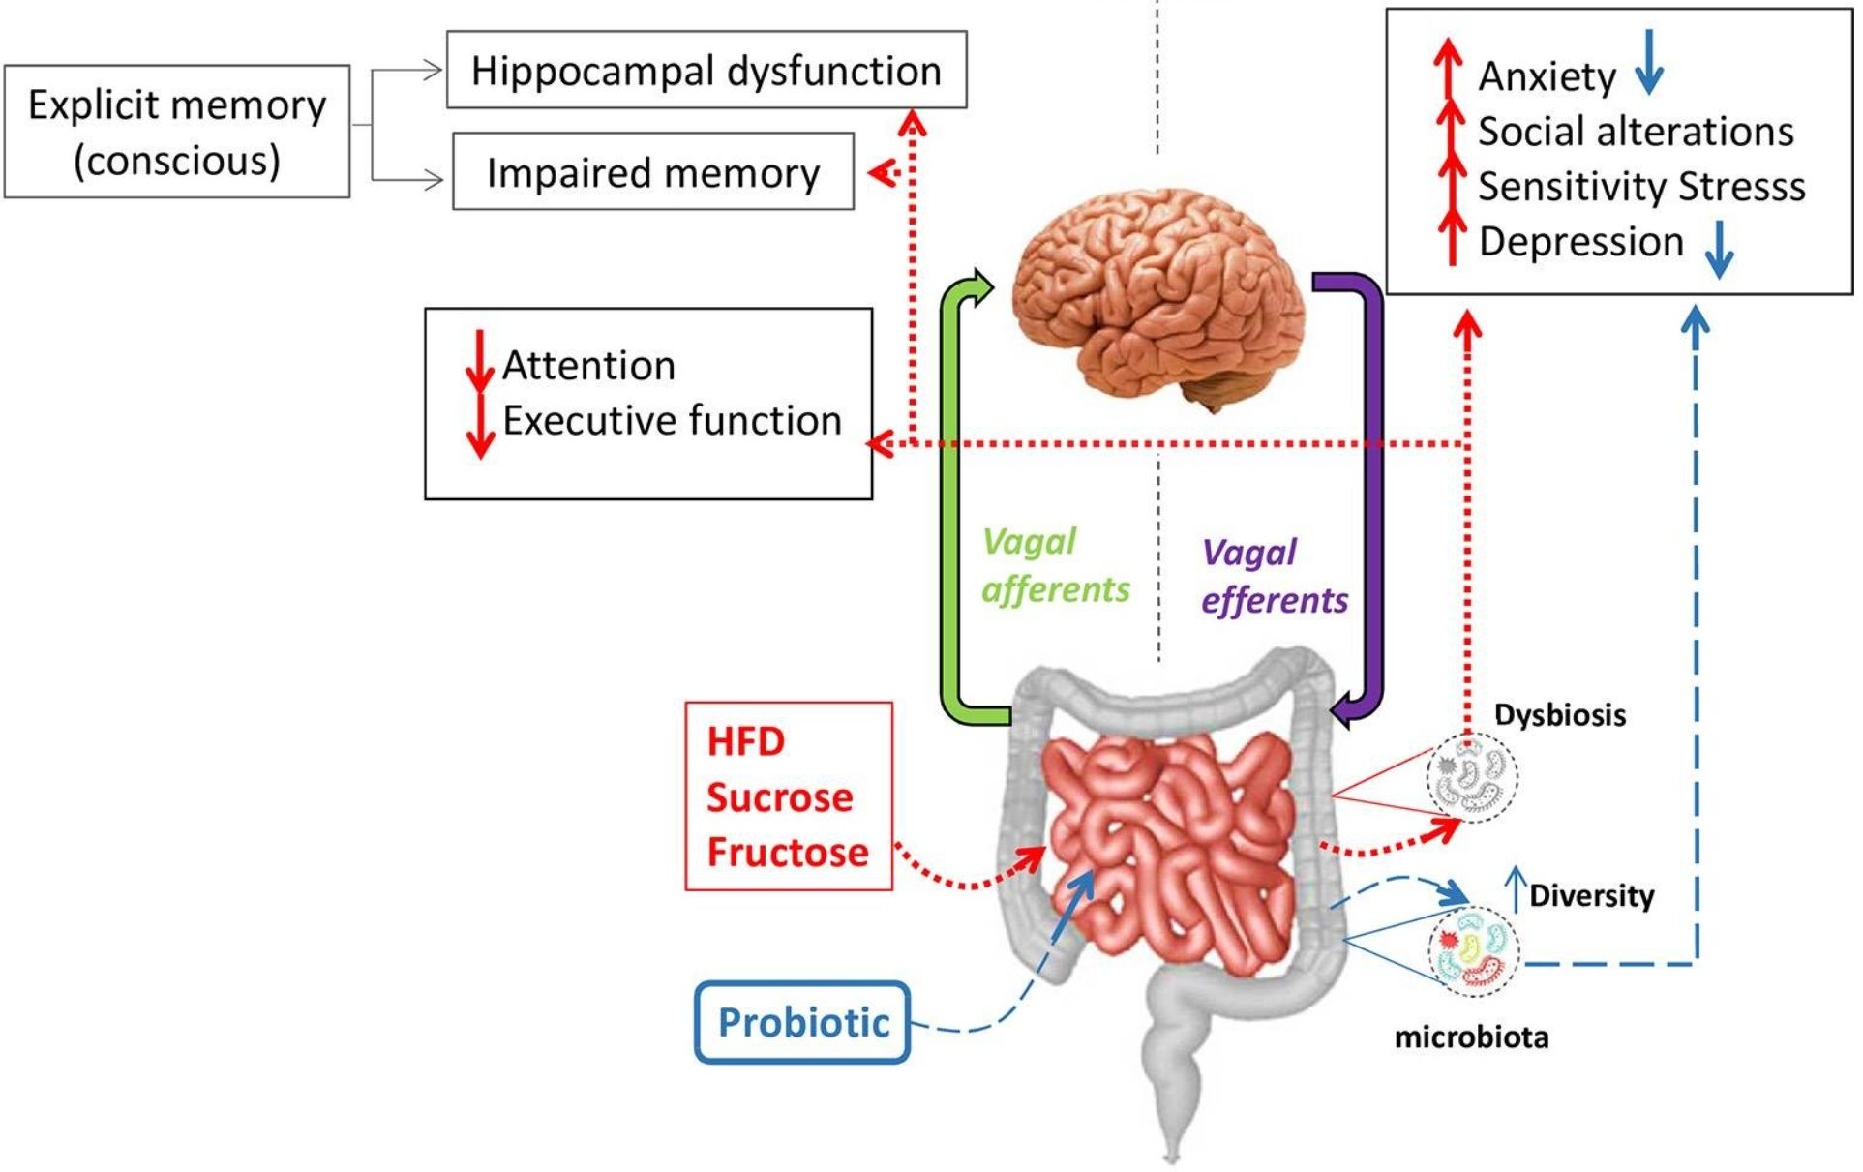
Alterazioni morfologiche e cognitive
Global atrophy and regional reduction of gray matter density, primarily in frontal regions, and independent of age and relevant clinical variables;
Metabolic alterations of prefrontal regions found to correlate with performance on tests of memory and executive function in young adults;
In older adults, obesity has been associated with disruption of frontal, temporal, and subcortical brain regions, others have found significant positive associations between BMI and burden of white matter lesions in older adults, independent of vascular factors such as hypertension;
While white matter volume did not differ between healthy obese and lean younger adults on MRI, newer diffusion tensor imaging studies have demonstrated an age-independent association between elevated BMI and reduced microstructural white matter integrity, measured via fractional anisotropy and mean diffusion values.

Slide 5
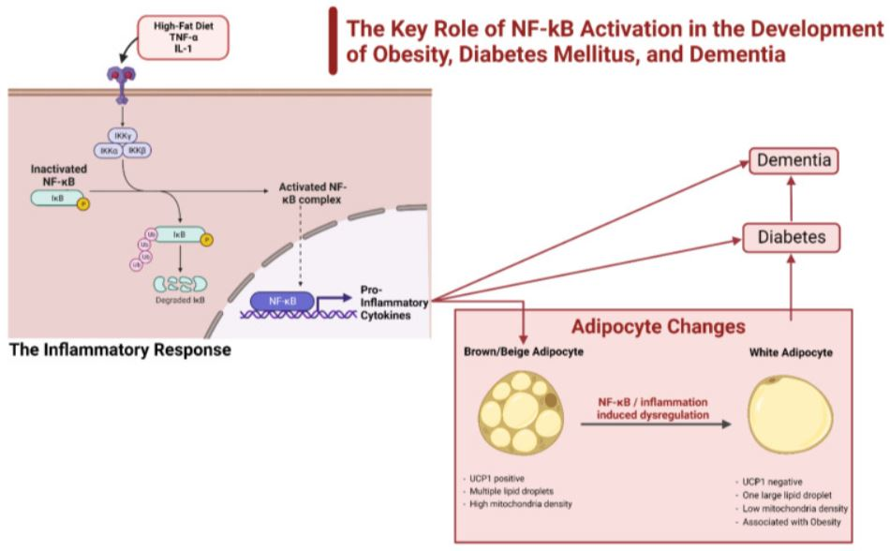
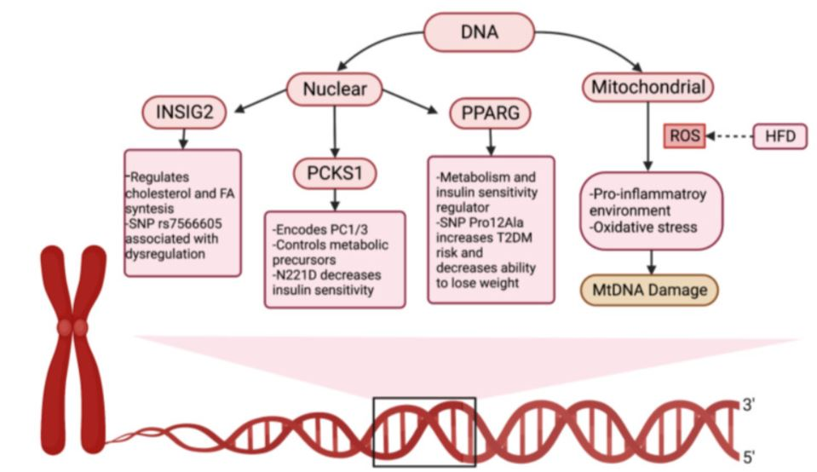
Cambiamenti genetici, epigenetici e infiammatori

Slide 6
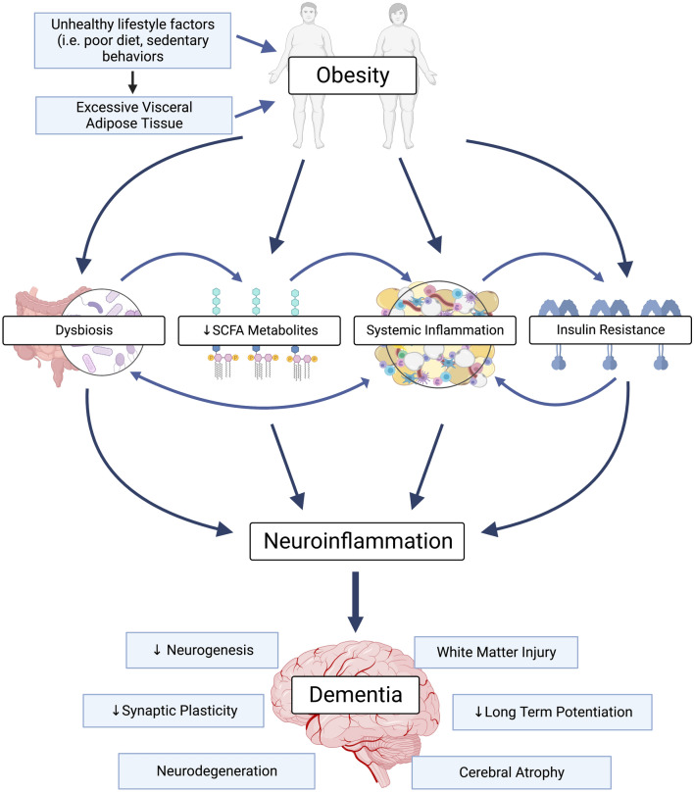
Obesità e demenza
The complex interplay between obesity, neuroinflammation and dementia
Unhealthy lifestyle factors contribute to excess visceral adipose accumulation in obesity, which promotes systemic inflammation and insulin resistance.
Obesity is also associated with gut dysbiosis and reduced short chain fatty acid (SCFA) metabolites.
These pathological features promote neuroinflammation which in turn promotes the pathological features of dementia (i.e. decreased neurogenesis, synaptic plasticity and long-term potentiation; the development of white matter lesions; neurodegeneration and cerebral atrophy). Ultimately, this may impair cognition and cause dementia.

Slide 7
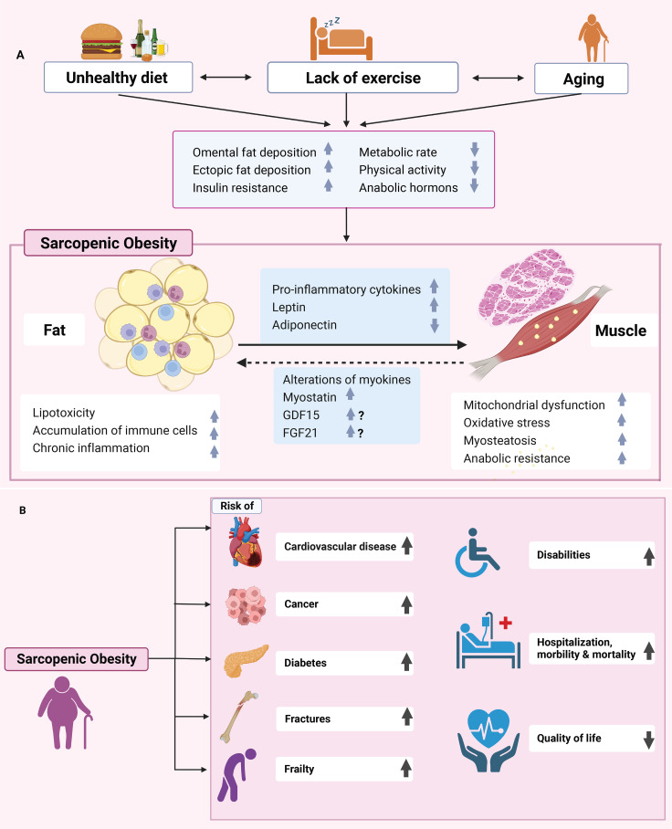
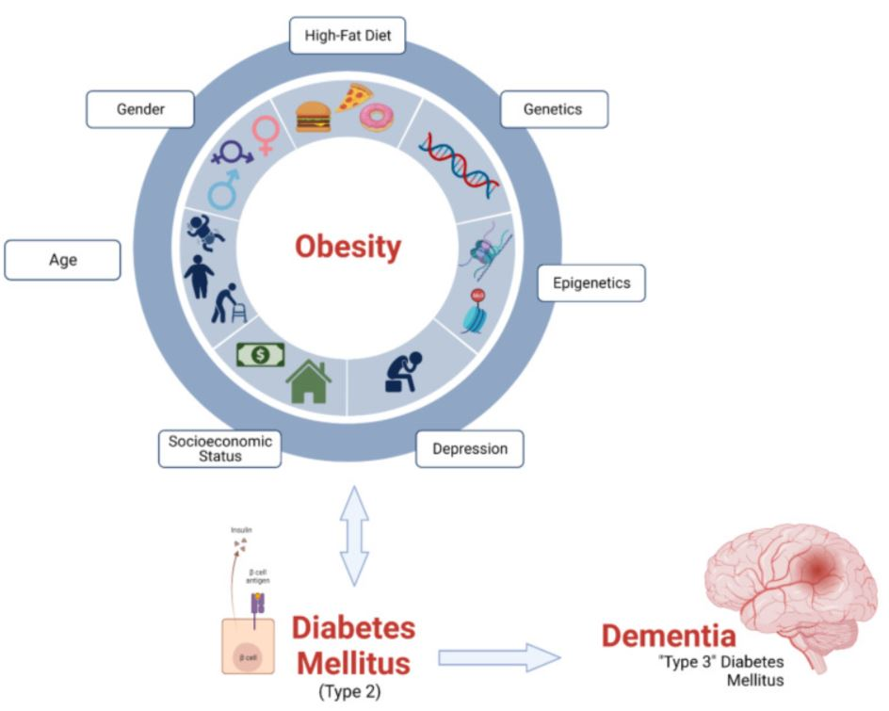
Obesità sarcopenica, diabete e demenza

Slide 8
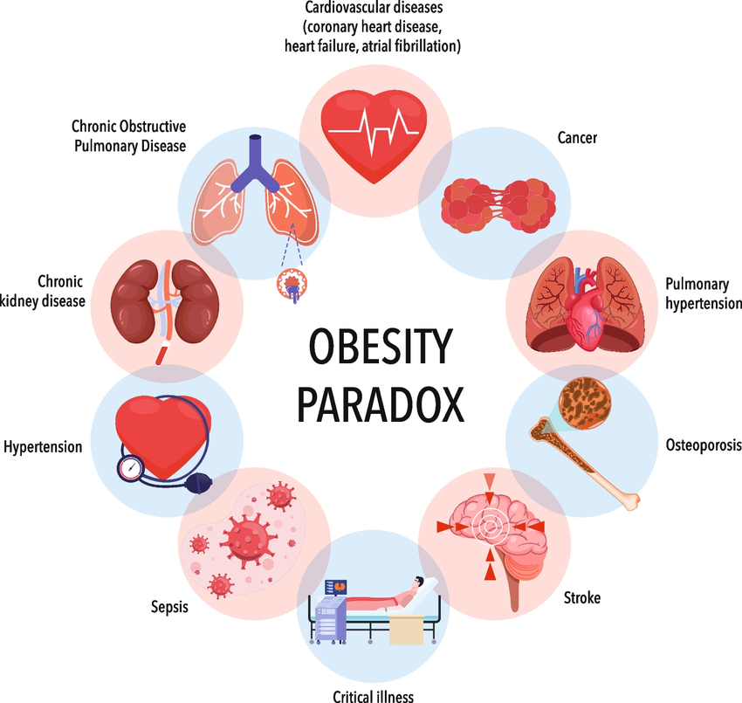
Obesity paradox

Slide 9
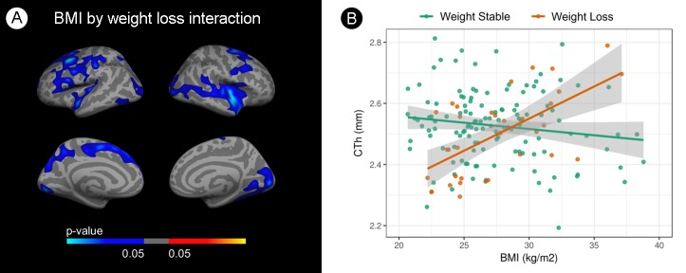
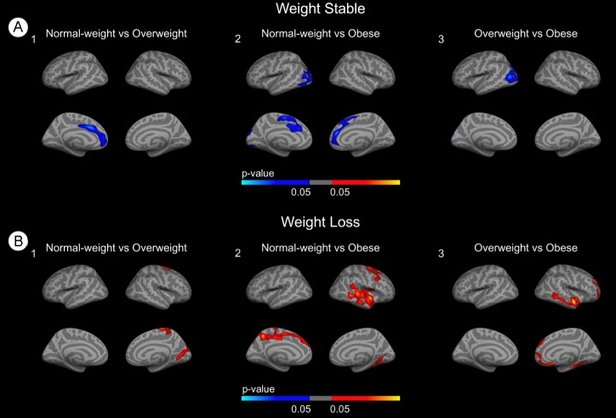
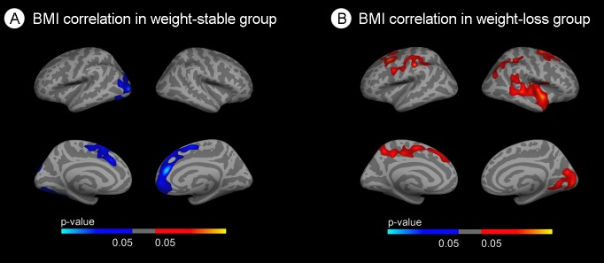
Obesity paradox e demenza
Pegueroles J, Jiménez A, Vilaplana E, Montal V, Carmona-Iragui M, Pané A, Alcolea D, Videla L, Casajoana A, Clarimón J, Ortega E, Vidal J, Blesa R, Lleó A, Fortea J; Alzheimer's Disease Neuroimaging Initiative. Obesity and Alzheimer's disease, does the obesity paradox really exist? A magnetic resonance imaging study. Oncotarget. 2018 Oct 5;9(78):34691-34698

Slide 10
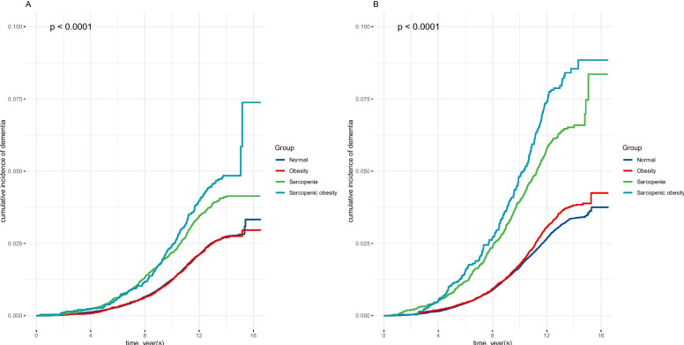
Obesity paradox, sarcopenia e demenza
Zhang J, Na X, Li Z, Ji JS, Li G, Yang H, Yang Y, Tan Y, Zhang J, Xi M, Su D, Zeng H, Wu L, Zhao A. Sarcopenic obesity is part of obesity paradox in dementia development: evidence from a population-based cohort study. BMC Med. 2024 Mar 22;22(1):133

Slide 11
Conclusioni
Cosa deve attenzionare il clinico?
Valutazione metabolica
Individuazione parametri antropometrici appropriati
Obesità sarcopenica
Valutazione delle funzioni cognitive

Slide 12
Bibliografia
Blüher M. Obesity: global epidemiology and pathogenesis. Nat Rev Endocrinol. 2019 May;15(5):288-298
Prickett C, Brennan L, Stolwyk R. Examining the relationship between obesity and cognitive function: a systematic literature review. Obes Res Clin Pract. 2015 Mar-Apr;9(2):93-113
Elias MF, Goodell AL, Waldstein SR. Obesity, cognitive functioning and dementia: back to the future. J Alzheimers Dis. 2012;30 Suppl 2:S113-25
Sellbom KS, Gunstad J. Cognitive function and decline in obesity. J Alzheimers Dis. 2012;30 Suppl 2:S89-95
Phirom K, Nantakool S, Chuatrakoon B, Rerkasem K. Role of obesity-related anthropometric indicators on cognitive function in obese older adults: A systematic review and meta-analysis. Public Health. 2025 Apr;241:60-68
Smith E, Hay P, Campbell L, Trollor JN. A review of the association between obesity and cognitive function across the lifespan: implications for novel approaches to prevention and treatment. Obes Rev. 2011 Sep;12(9):740-55
Wei S, Nguyen TT, Zhang Y, Ryu D, Gariani K. Sarcopenic obesity: epidemiology, pathophysiology, cardiovascular disease, mortality, and management. Front Endocrinol (Lausanne). 2023 Jun 30;14:1185221
Dye L, Boyle NB, Champ C, Lawton C. The relationship between obesity and cognitive health and decline. Proc Nutr Soc. 2017 Nov;76(4):443-454
Selman A, Burns S, Reddy AP, Culberson J, Reddy PH. The Role of Obesity and Diabetes in Dementia. Int J Mol Sci. 2022 Aug 17;23(16):9267
Le Thuc O, García-Cáceres C. Obesity-induced inflammation: connecting the periphery to the brain. Nat Metab. 2024 Jul;6(7):1237-1252
Wong Zhang DE, Tran V, Vinh A, Dinh QN, Drummond GR, Sobey CG, Jelinic M, De Silva TM. Pathophysiological Links Between Obesity and Dementia. Neuromolecular Med. 2023 Dec;25(4):451-456 (slide 6)
Zhang J, Na X, Li Z, Ji JS, Li G, Yang H, Yang Y, Tan Y, Zhang J, Xi M, Su D, Zeng H, Wu L, Zhao A. Sarcopenic obesity is part of obesity paradox in dementia development: evidence from a population-based cohort study. BMC Med. 2024 Mar 22;22(1):133
Natale G, Zhang Y, Hanes DW, Clouston SA. Obesity in Late-Life as a Protective Factor Against Dementia and Dementia-Related Mortality. Am J Alzheimers Dis Other Demen. 2023 Jan-Dec;38:15333175221111658
Wei J, Zhu X, Liu J, Gao Y, Liu X, Wang K, Zheng X. Estimating global prevalence of mild cognitive impairment and dementia in elderly with overweight, obesity, and central obesity: A systematic review and meta-analysis. Obes Rev. 2025 May;26(5):e13882
Machado-Fragua MD, Sabia S, Fayosse A, Hassen CB, van der Heide F, Kivimaki M, Singh-Manoux A. Is metabolic-healthy obesity associated with risk of dementia? An age-stratified analysis of the Whitehall II cohort study. BMC Med. 2023 Nov 14;21(1):436
Ding Y, Ge T, Shen J, Duan M, Yuan C, Zhu Y, Zhou D. Associations of metabolic heterogeneity of obesity with the risk of dementia in middle-aged adults: three prospective studies. Alzheimers Res Ther. 2024 Oct 11;16(1):220
Liang Z, Qin H, Su B, Bao Y, Vitiello MV, Hu G, Wang Y. Trajectories of general and central obesity beyond middle age in relation to late-life cognitive decline and dementia. Obesity (Silver Spring). 2025 Feb;33(2):405-415

Slide 13
Grazie

